Slide 1
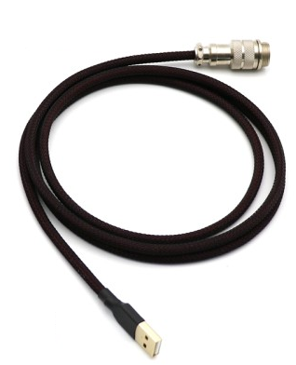


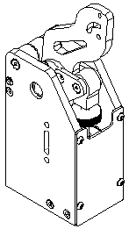
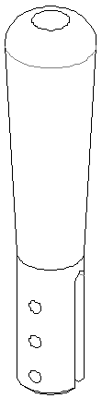
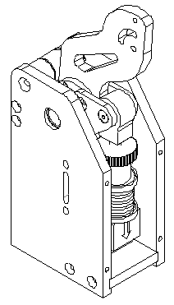
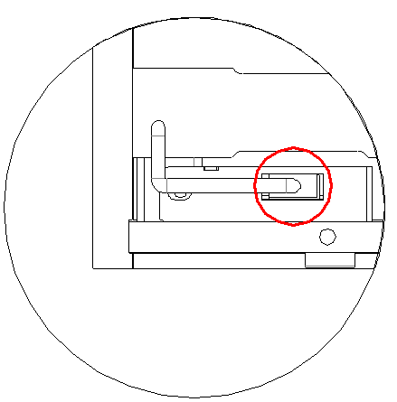
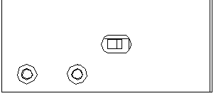
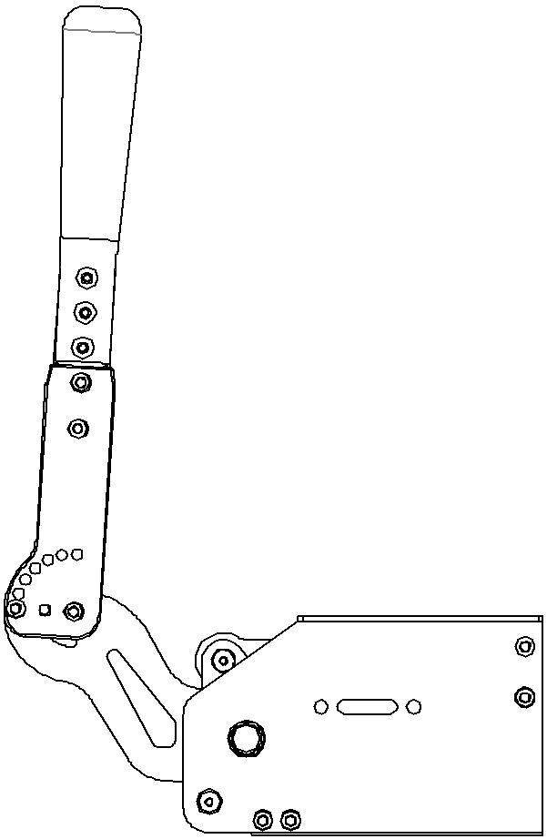
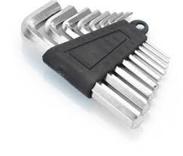

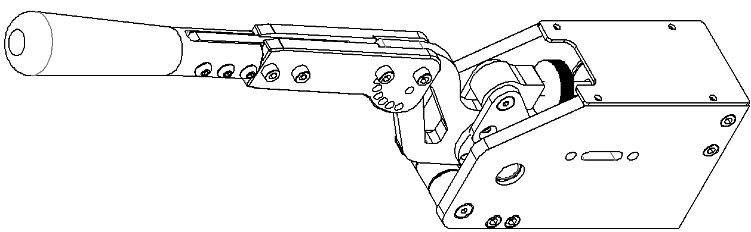
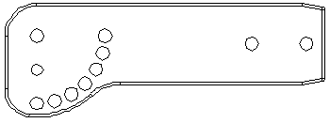
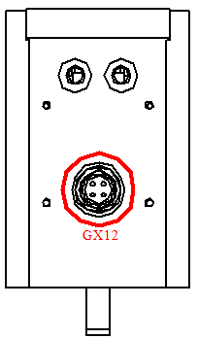

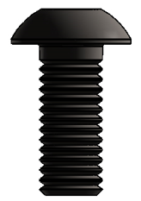
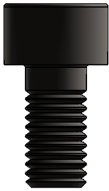

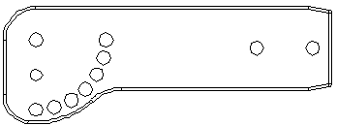

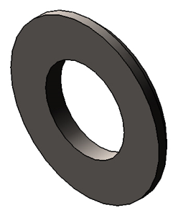

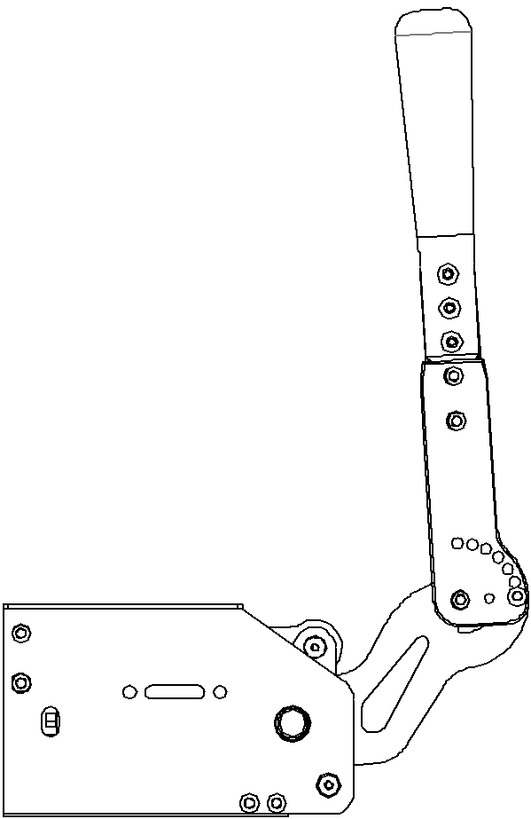
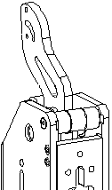
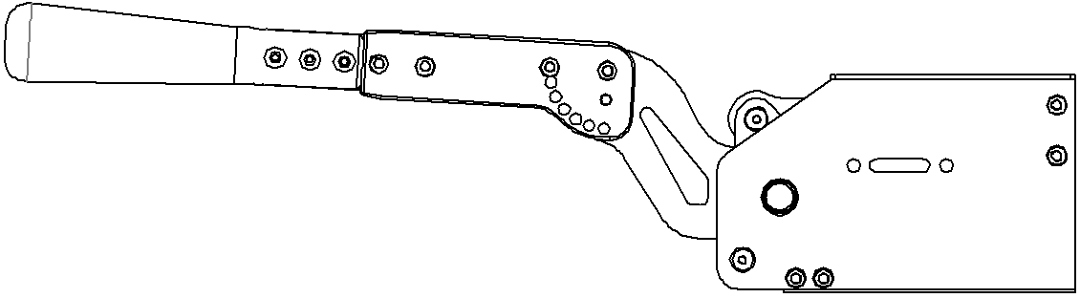










VNM HANDBRAKE V1.5
Quick Guide
Content
Connection
2
On the left side of the Handbrake: XH2.54-4P port for load cell connection
On the right side of the Handbrake is:
Switch DFU/Game Mode
Slide left side to select DFU Mode or right side to select Game Mode
1
4
5
3
6
DFU RUN
7
X2
VNM Handbrake V1.5
Designed by VNM Simualtion
Made in Vietnam
1. VNM Handbrake V1.5 body
2. Red (stiffest), blue (stiffer) springs
3. Allen key set
4. USB A male – GX12 male cable
5. Handle
6. Handle extension
7. 0-90 degree conversion adapter (2 pcs)
At the bottom of the Handbrake: GX12 female port
Set up
Adjust Handbrake
0$°$
M5x10
M5x12
M5x10
X4
X6
X4
7 angle options
15$°$
X5
30$°$
M5x20
Adjust Spring & elastomer:
Twist the threaded cap:
Clockwise: Heavier pull force
Counter-clockwise: Lighter pull force
X2
45$°$
+
_
90$°$
75$°$
60$°$
X1
X1
Choose the appropriate handle height
X1
Adjust the angle of inclination:
Remove the 2 bolts on both sides
Pull out the endstop part
Choose the angle of inclination by rotating the endstop part
Push the endstop part in the sliding slot
Tighten the bolts.
Choose the appropriate angle/inclination
Handbrake V1.5 set up for 0$°$ handle
VNM Handbrake V1.5 set up for 90$°$ handle

Slide 2
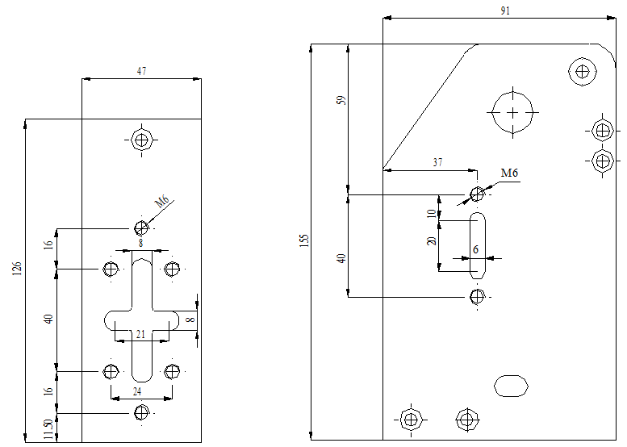
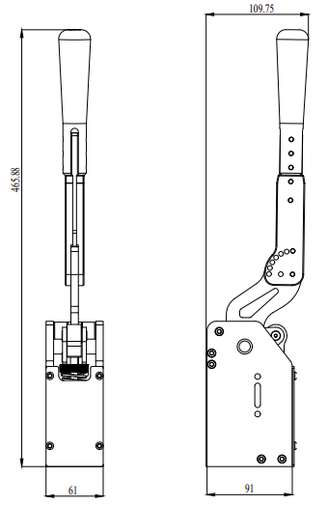
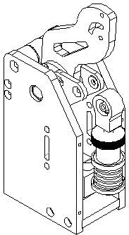
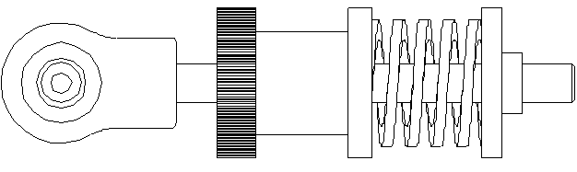
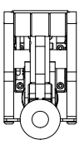
Mounting Drawing
Clamps Size
Exchange Spring
Remove bolts
Remove bolts
Blue spring
OR
Tighten bolts
Tighten bolts
Red spring

